Slide 1
DETECTION AND CLASSIFICATION OF PERIAPICAL DENTAL X-RAY IMAGES BY APPLYING IMAGE PROCESSING TECHNIQUE
PROJECT MEMBERS:
ABINAYA B - 211418104006
GAYATHRI R -211418104061
INDHUMATHI M -211418104089
PROJECT GUIDE:
Dr.L.JABASHEELA

Slide 2
INTRODUCTION:
Periapical X-rays show the entire tooth, from the exposed crown to the end of the root and the bones that support the tooth. These X-rays are used to find dental problems below the gum line or in the jaw, such as impacted teeth, tooth fractures, abscesses, tumours and bone changes linked to some diseases.
It described the innovative solution that provides efficient disease detection and deep learning with convolutional neural networks (CNN’s) has achieved great success in the classification of various dental diseases.
A variety of neuron-wise and layer-wise visualization methods were applied using a CNN, trained with a publicly available dental disease given image dataset.
So, it observed that neural networks can capture the colors and textures of lesions specific to respective diseases upon diagnosis, which resembles human decision-making.

Slide 3
LITERATURE SURVEY:
TITLE | DESCRIPTION
1). Sindu Divakaran, Suja D, “Classification of Digital Dental X-ray Images Using Machine Learning” ,2021, IEEE,DOI:10.1109.[15] | Dental conditions like dental anomalies, periapical and dental caries is adding day by day in children and adults. Artificial intelligence and neural network with its application in medical imaging is impacting the healthcare industry
2). Amaar Obaid Hassan, Gregory Y. H. Lip, “Acute Dental Periapical Abscess and New-Onset Atrial Fibrillation: A Nationwide, Population-Based Cohort Study”,2021, MDPI ,DOI:10.3390.[2] | This study aims to assess the relationship that is between acute periapical abscess and incident AF.
3). Anuj Kumar, “Descriptive analysis of dental X-ray images using various practical methods” ,2021, PeerJ, DOI:10.7717.[3] | In dentistry, interpreters interpret numerous dental X-ray imaging modalities to identify tooth-related problems, abnormalities, or teeth structure changes.

Slide 4
PROBLEM STATEMENT:
The goal is to develop a deep learning model for dental disease image classification by convolutional neural network algorithm for potentially classifying the results in the form of best accuracy by comparing the CNN architectures. Most of the related works classifies the disease with three classifiers, i.e. Primary Endo with Secondary Perio, Primary Periodontal Lesion, True Combined Lesions.
To classify dental Disease Classification over static facial images using deep learning techniques was developed. This is a complex problem that has already been approached several times with different techniques. While good results have been achieved using feature engineering, this project focused on feature learning, which is one of DL promises. The solution totally based on feature learning does not seem close yet because of a major limitation. Thus, Disease classification could be achieved by means of deep learning techniques.

Slide 5
DEVELOPMENT ENVIRONMENT:
1. Software Requirements:
Operating System : Windows
Tool : Anaconda with Jupyter Notebook
2. Hardware requirements:
Processor : Intel core i3
Hard disk : minimum 300 GB
RAM : minimum 4 GB

Slide 6
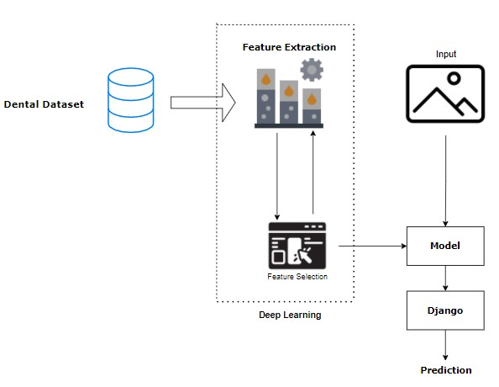
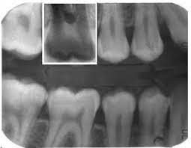
SYSTEM ARCHITECTURE:

Slide 7
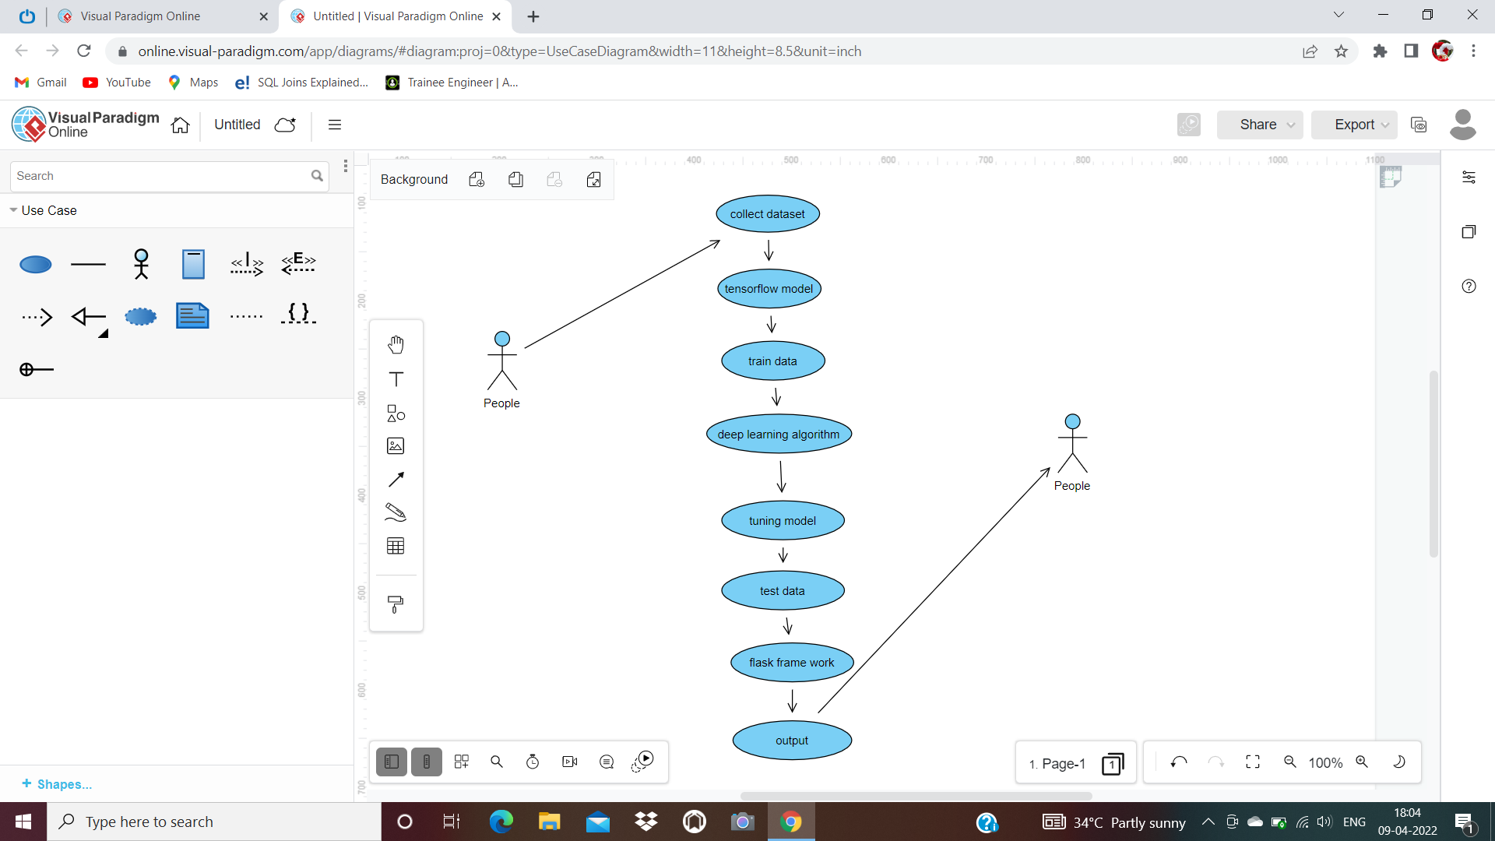



USE CASE DIAGRAM:

Slide 8
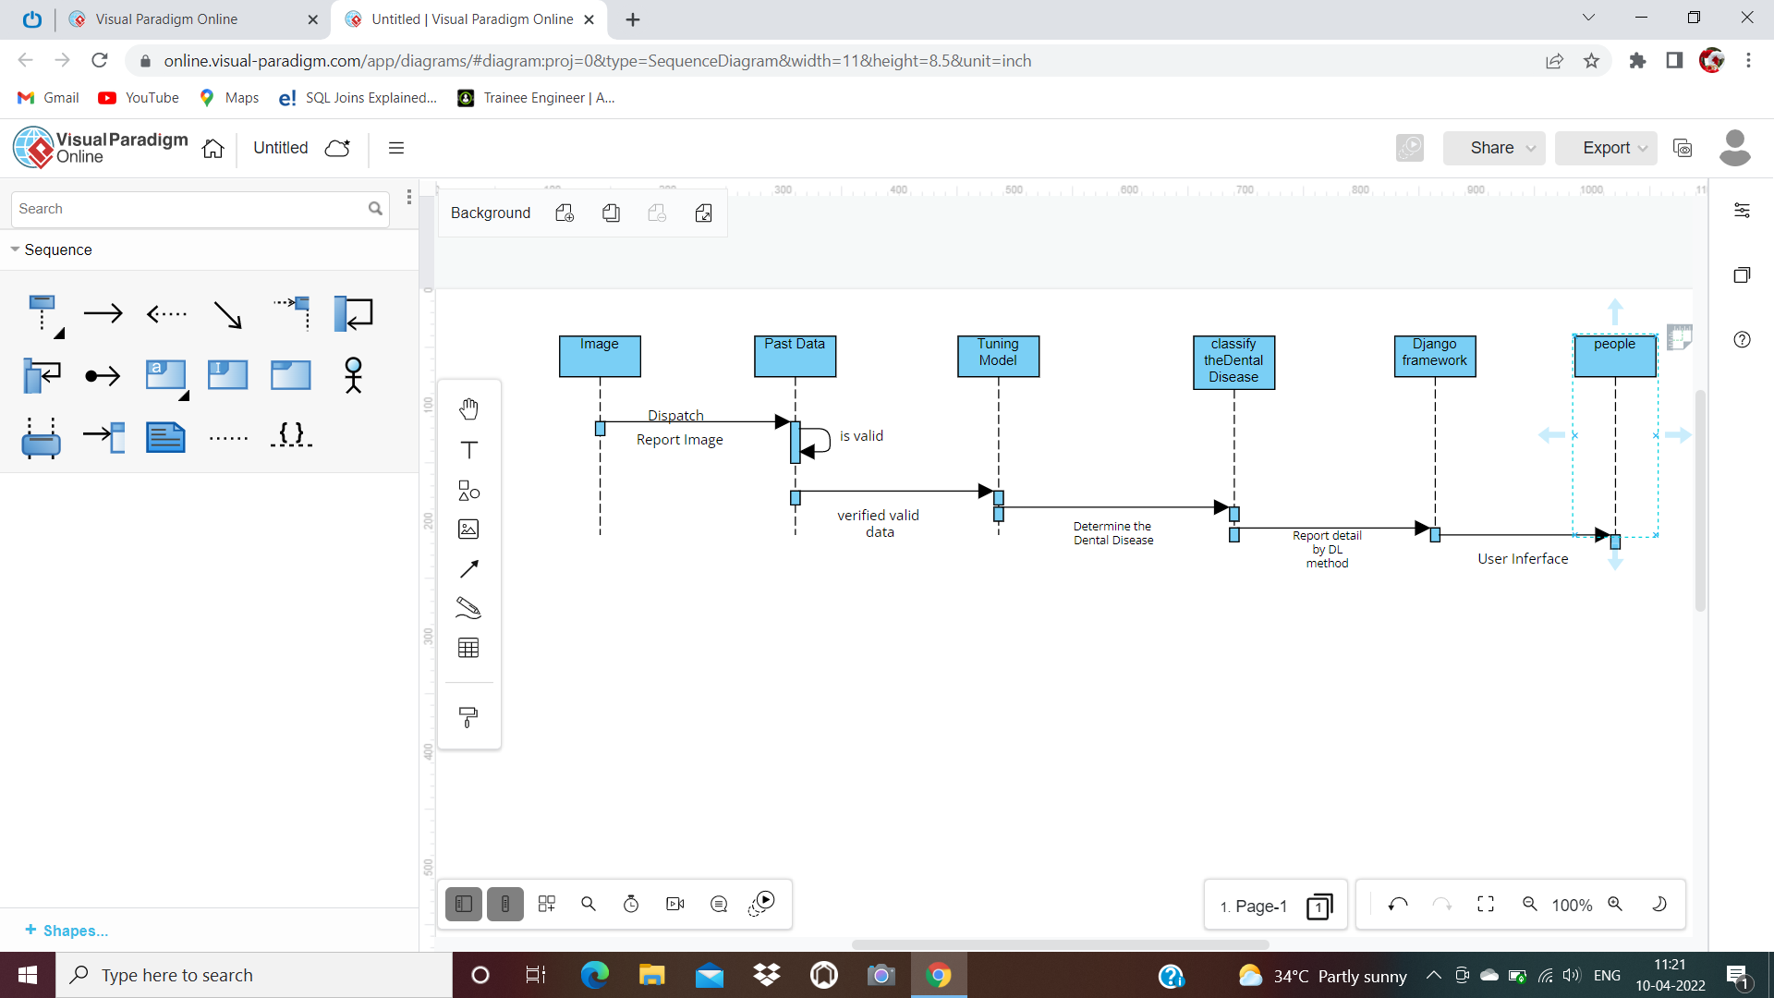
SEQUENCE DIAGRAM:

Slide 9
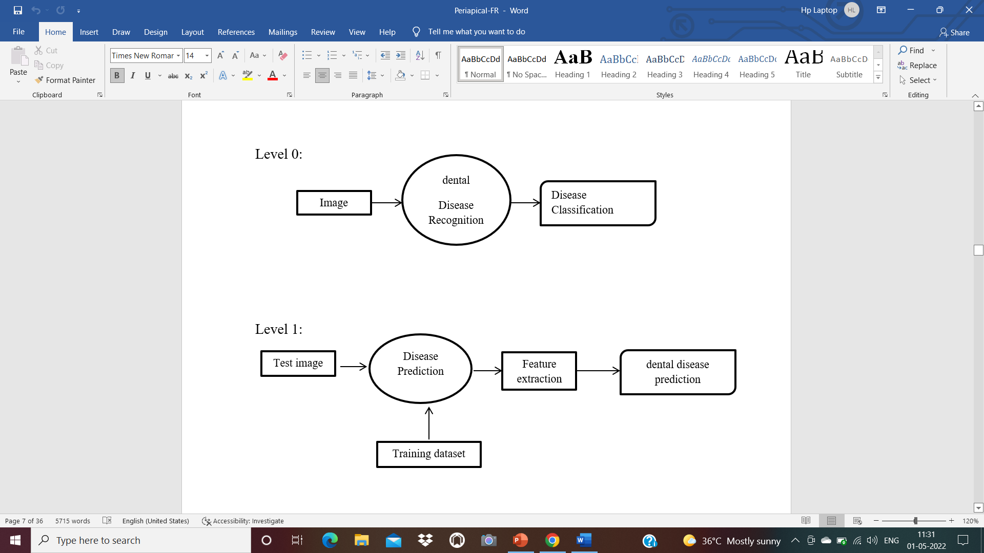
DATA FLOW DIAGRAM:
Level 1:

Slide 10
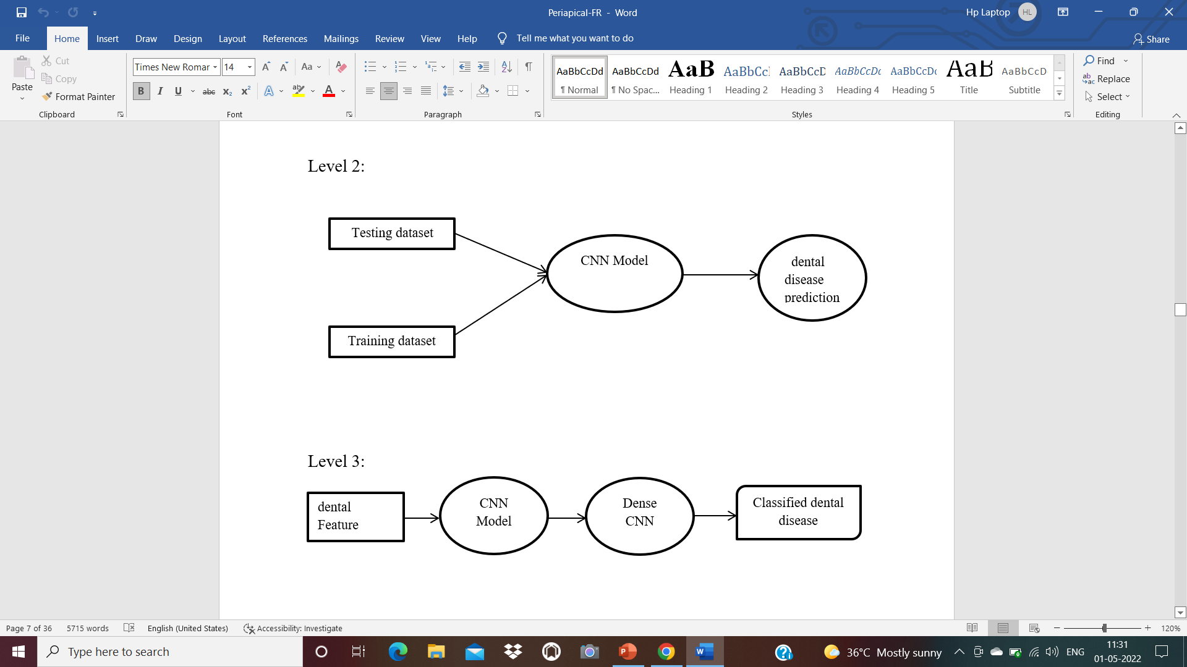
Data Flow Diagram:

Slide 11
MODULE DESCRIPTION:
1. IMPORT THE GIVEN IMAGE FROM DATASET:
We have to import our data set using keras preprocessing image data generator function also we create size, rescale, range, zoom range, horizontal flip. Then we import our image dataset from folder through the data generator function.
Here we set train, test, and validation also we set target size, batch size and class-mode from this function we have to train using our own created network by adding layers of CNN.
2. TO TRAIN THE MODULE BY GIVEN IMAGE DATASET:
To train our dataset using classifier and fit generator function also we make training steps per epoch’s then total number of epochs, validation data and validation steps using this data we can train our dataset.

Slide 12
3. WORKING PROCESS OF LAYERS IN CNN MODEL:
A Convolutional Neural Network (ConvNet/CNN) is a Deep Learning algorithm which can take in an input image, assign importance (learnable weights and biases) to various aspects/objects in the image and be able to differentiate one from the other.
The pre-processing required in a ConvNet is much lower as compared to other classification algorithms. While in primitive methods filters are hand-engineered, with enough training, ConvNets have the ability to learn these filters/characteristics.

Slide 13
Input Layer:
Input layer in CNN contain image data. Image data is represented by three dimensional matrixes.
It needs to reshape it into a single column. Suppose you have image of dimension 28 x 28 =784, it need to convert it into 784 x 1 before feeding into input.
Convo Layer:
Convo layer is sometimes called feature extractor layer because features of the image are get extracted within this layer.
First of all, a part of image is connected to Convo layer to perform convolution operation as we saw earlier.

Slide 14
Pooling Layer:
Pooling layer is used to reduce the spatial volume of input image after convolution. It is used between two convolution layers.
If it applies FC after Convo layer without applying pooling or max pooling, then it will be computationally expensive.
Fully Connected Layer (FC):
Fully connected layer involves weights, biases, and neurons. It connects neurons in one layer to neurons in another layer.
It is used to classify images between different categories by training.

Slide 15
Softmax / Logistic Layer:
Softmax or Logistic layer is the last layer of CNN. It resides at the end of FC layer.
Logistic is used for binary classification and softmax is for multi-classification.
Output Layer:
Output layer contains the label which is in the form of one-hot encoded. Now you have a good understanding of CNN.

Slide 16
4. DENTAL DISEASE CLASSIFICATIONS:
We give input image using keras preprocessing package. That input Image converted into array value using pillow and image to array function package. We have already classified dental in our dataset. It classifies what are Disease. Then we have to predict our Disease using predict function.
The dental recognition method is based on a two-channel architecture that is able to recognize. The dental parts are cropped and extracted and then used as the input into the inception layer of the CNN. The Training phase involves the feature extraction and classification using convolution neural network.

Slide 17
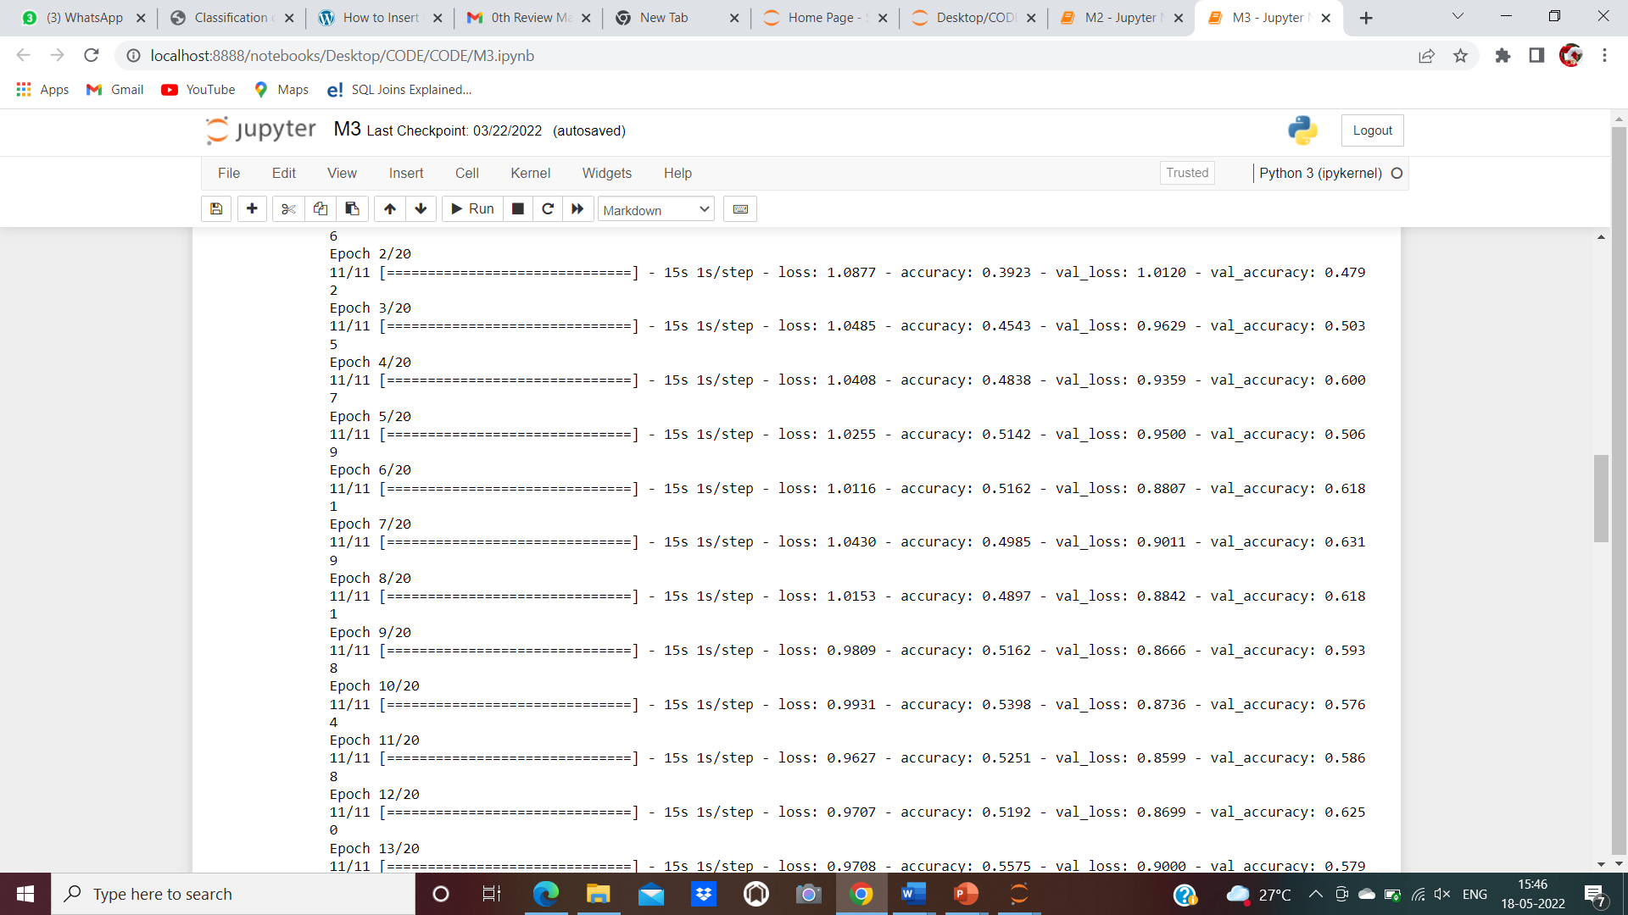
PERFORMANCE EVALUATION:

Slide 18

SCREENSHOTS:

Slide 19
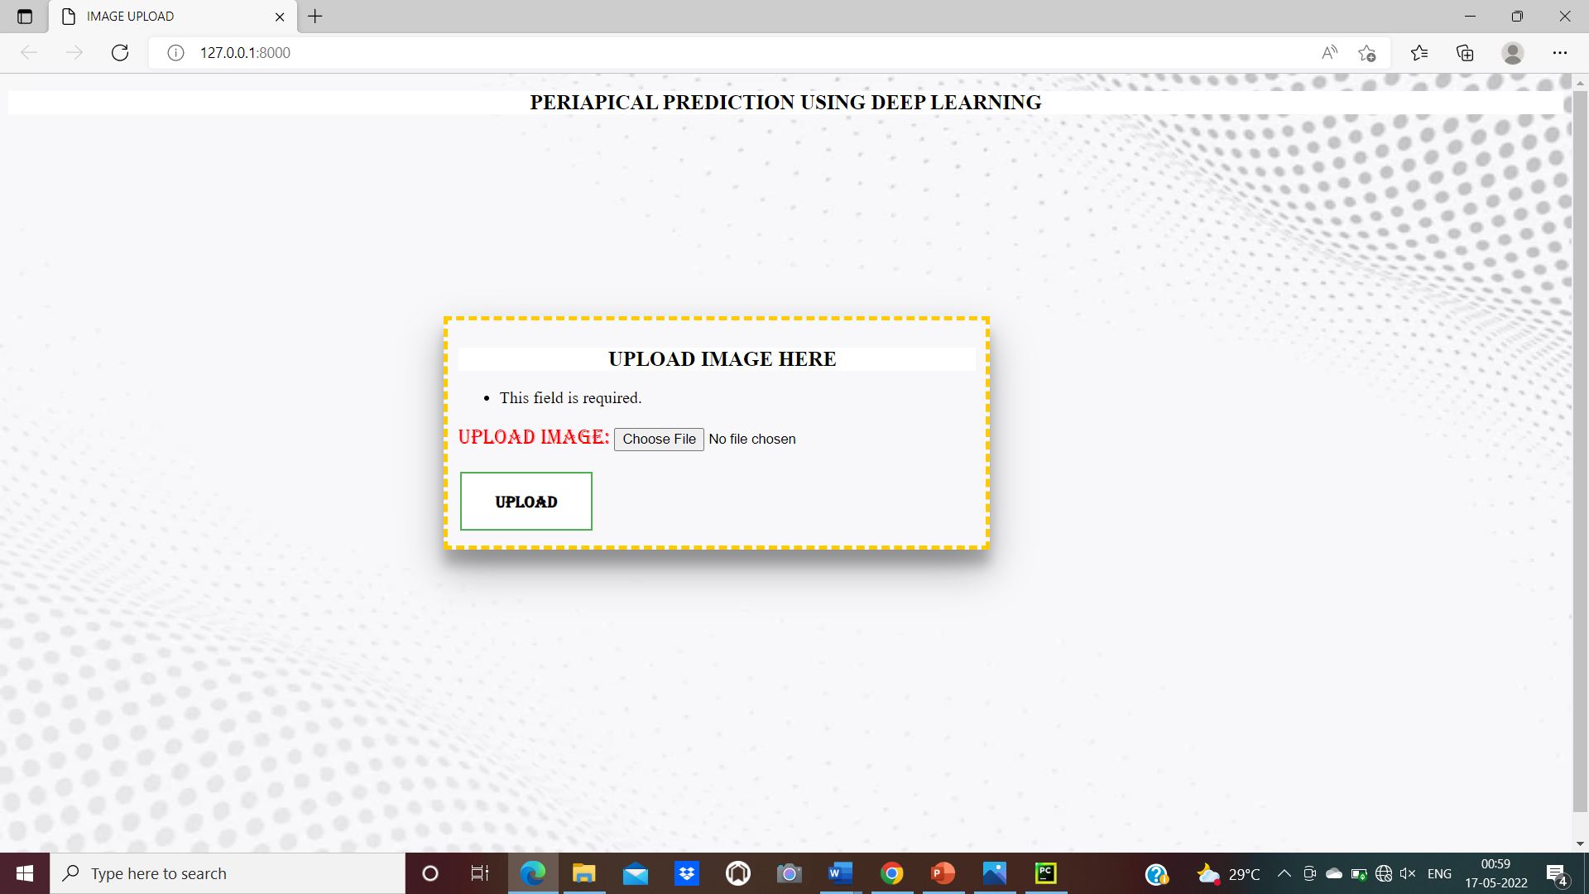

Slide 20
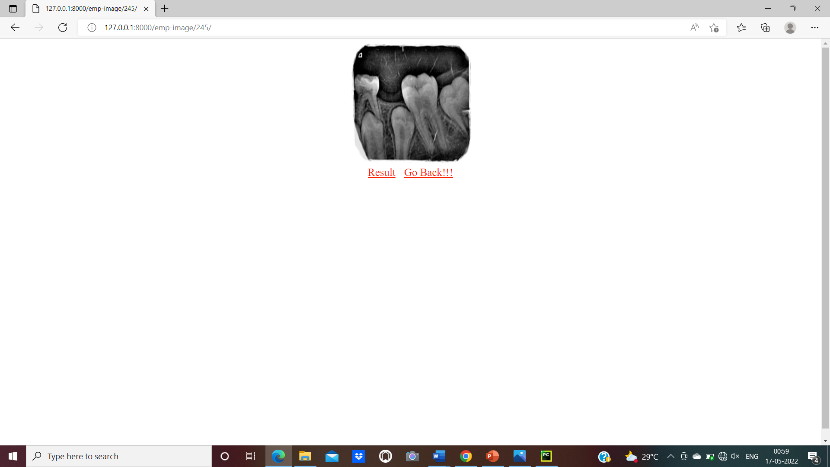

Slide 21
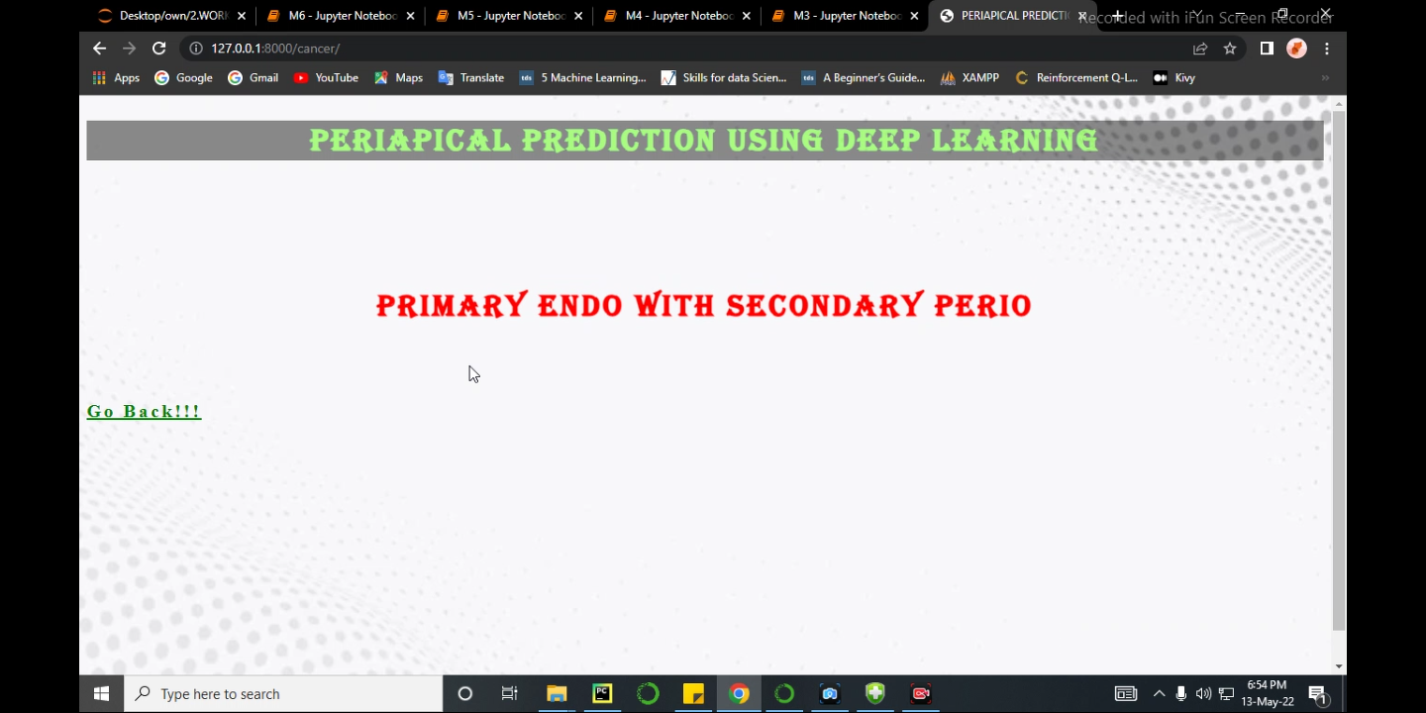

Slide 22
CONCLUSION:
In this project, a research to classify dental Disease Classification over static facial images using deep learning techniques was developed. This is a complex problem that has already been approached several times with different techniques. While good results have been achieved using feature engineering, this project focused on feature learning, which is one of DL promises. While feature engineering is not necessary, image pre-processing boosts classification accuracy. Hence, it reduces noise on the input data. Nowadays, Agriculture based AI dental disease includes is heavily required. The solution totally based on feature learning does not seem close yet because of a major limitation. Thus, Disease classification could be achieved by means of deep learning techniques

Slide 23
References:
1. Sindu Divakaran , Suja D,2021, “Classification of Digital Dental X-ray Images Using Machine Learning “.
2. Amaar Obaid Hassan, Gregory Y. H. Lip,2021,“Acute Dental Periapical Abscess and New-Onset Atrial Fibrillation: A Nationwide, Population-Based Cohort Study”.
3. Anuj Kumar,2021,” Descriptive analysis of dental X-ray images using various practical methods”.
4. Kasra KARAMIFAR, Afsoon TONDARI, Mohammad Ali SAGHIRI,2020,” Endodontic Periapical Lesion: An Overview on the Etiology, Diagnosis and Current Treatment Modalities”.
5. Vicente Rueda, Ulises Velazquez,2020,” Using the Periapical Index to evaluate the healing of periapical lesions after root canal treatment”.

Slide 24
6. Parkavi . B, Roshini . T.J, Roshini. T, M. Maheswari,2019,“Segmentation of Periapical Dental X-Ray Images by Applying Morphological Operation”.
7. Jiafa Mao, Kaihui Wang, Yahong Hu, Weiguo Sheng, Qixin Feng, 2018, “GrabCut algorithm for dental X-ray images based on full threshold segmentation”.
8. Sibel Koçak, Mustafa Murat,2013,” Periapical Health Related to the Quality of Coronal Restorations and Root Fillings in a Turkish Population”.
9. Abdolvahab Ehsani Rad, Rosely KumoiMohd Shafry Mohd Rahim, Alireza Norouzi,2 012 , ‘Dental X-Ray Image Segmentation and Multiple Feature Extraction”.
10. P.N.R. Nair,2004,“Pathogenesis of apical periodontities and the causes of Endodontic Failures”.

Slide 25


